Slide 1
Unit-2 Linear Data Structure (Linked List)
Data Structures (DS)
GTU # 3130702
Computer Engineering Department

Slide 2
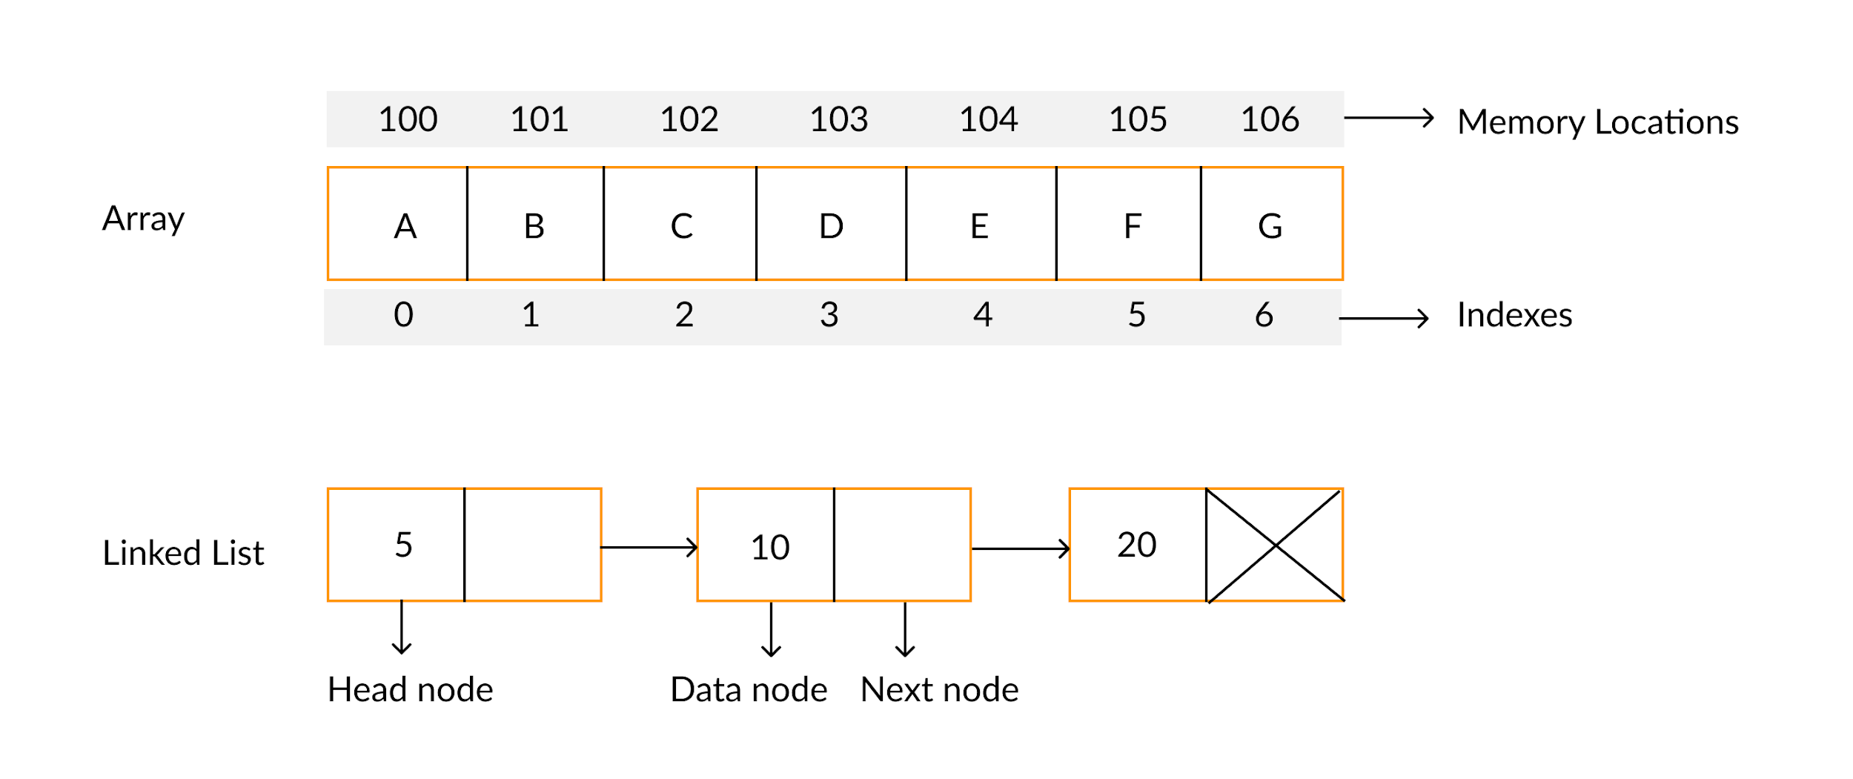

Array v/s Linked List

Slide 3
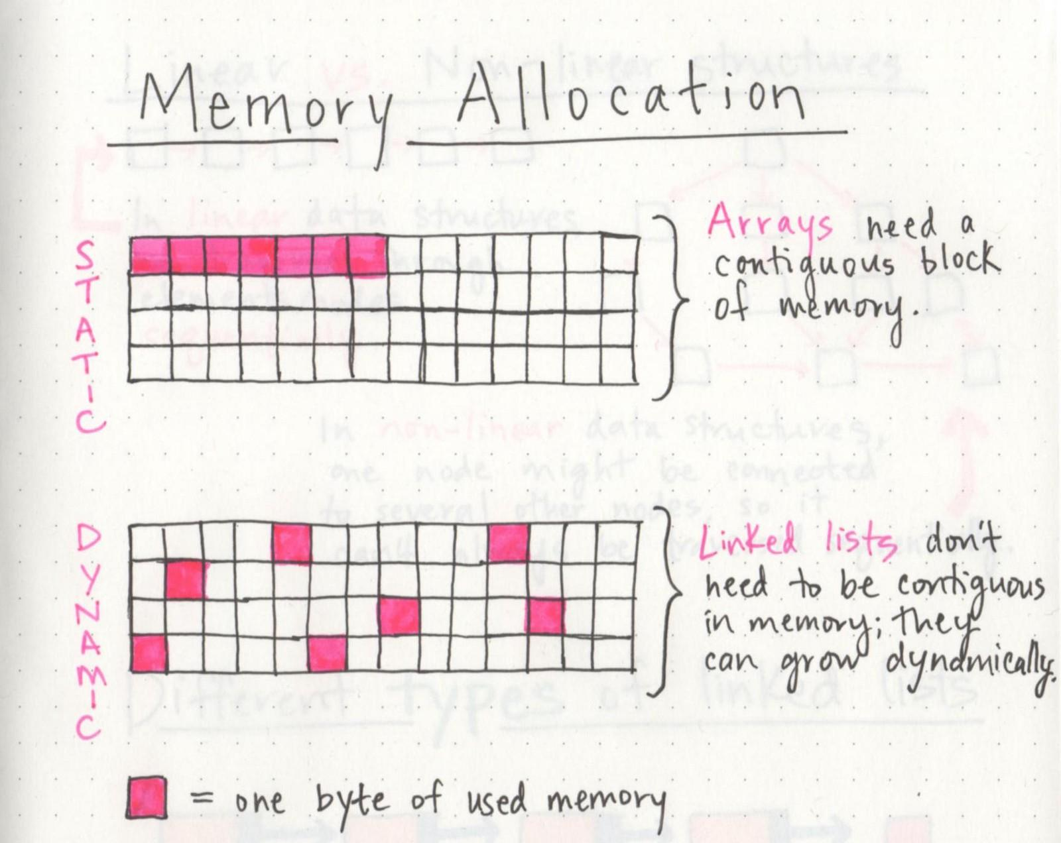
Array v/s Linked List

Slide 4
Array v/s Linked List
Arrays and Linked Lists are both linear data structures.
An array is a collection of elements of a similar data type.
Linked List is an ordered collection of elements of the same type in which each element is connected to the next using pointers.
Array elements can be accessed randomly using the array index.
Random accessing is not possible in linked lists. The elements will have to be accessed sequentially.
Data elements are stored in contiguous locations in memory.
New elements can be stored anywhere and a reference is created for the new element using pointers.

Slide 5
Array v/s Linked List
Insertion and Deletion operations are costlier since the memory locations are consecutive and fixed.
Insertion and Deletion operations are fast and easy in a linked list.
Memory is allocated during the compile time (Static memory allocation).
Memory is allocated during the run-time (Dynamic memory allocation).
Size of the array must be specified at the time of array declaration/initialization.
Size of a Linked list grows/shrinks as and when new elements are inserted/deleted.

Slide 6
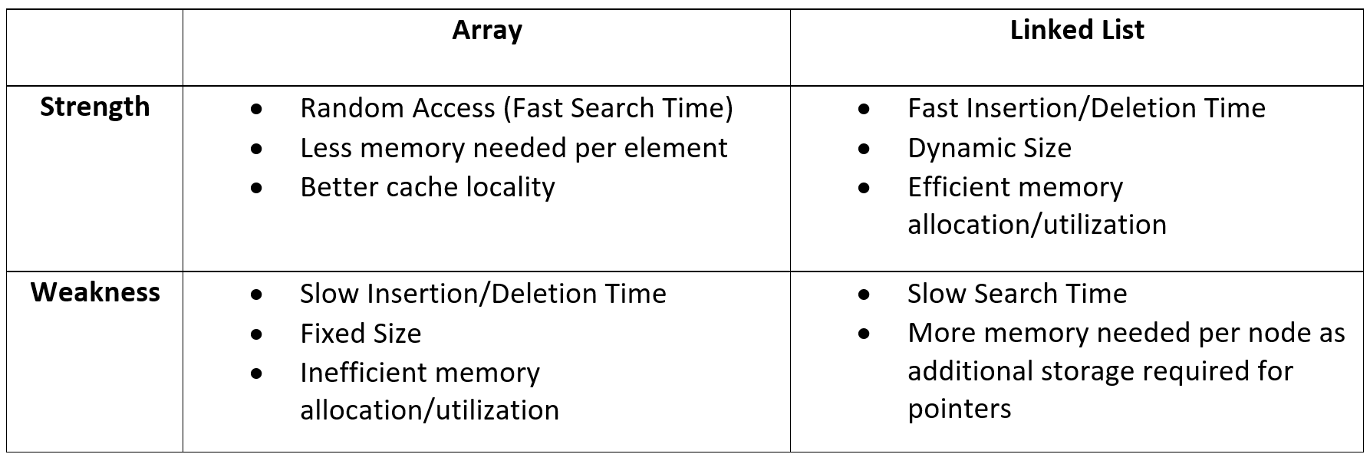
Array v/s Linked List

Slide 7
Advantages of Linked Lists
Size of linked lists is not fixed, they can expand and shrink during run time.
Insertion and Deletion Operations are fast and easier in Linked Lists.
Memory allocation is done during run-time (no need to allocate any fixed memory).
Data Structures like Stacks, Queues, and trees can be easily implemented using Linked list.

Slide 8
Disadvantages of Linked Lists
Memory consumption is more in Linked Lists when compared to arrays. Because each node contains a pointer in linked list and it requires extra memory.
Elements cannot be accessed at random in linked lists.
Traversing from reverse is not possible in singly linked lists.

Slide 9
Linked Storage Representation
There are many applications where sequential allocation method is unacceptable because of following characteristics
Unpredictable storage requirement
Extensive manipulation of stored data
One method of obtaining the address of node is to store address in computer’s main memory, we refer this addressing mode as pointer of link addressing.
A simple way to represent a linear list is to expand each node to contain a link or pointer to the next node. This representation is called one-way chain or Singly Linked Linear List.

Slide 10
Linked Storage Representation
NULL Value
Last Node
A
1000
B
2050
C
3335
D
5000
1000
2050
3335
A linked List
The linked allocation method of storage can result in both efficient use of computer storage and computer time.
A linked list is a non-sequential collection of data items.
Each node is divided into two parts, the first part represents the information of the element and the second part contains the address of the next mode.
The last node of the list does not have successor node, so null value is stored as the address.
It is possible for a list to have no nodes at all, such a list is called empty list.

Slide 11
Pros & Cons of Linked Allocation
Insertion Operation
We have an n elements in list and it is required to insert a new element between the first and second element, what to do with sequential allocation & linked allocation?
Insertion operation is more efficient in Linked allocation.
A
1000
B
2050
C
3335
D
5000
1000
2050
3335
A
2100
B
2050
C
3335
D
5000
1000
2050
3335
X
1000
2100

Slide 12
Pros & Cons of Linked Allocation
Deletion Operation
Deletion operation is more efficient in Linked Allocation
A
1000
B
2050
C
3335
D
5000
1000
2050
3335
A
2050
B
2050
C
3335
D
5000
1000
2050
3335

Slide 13
Pros & Cons of Linked Allocation
Search Operation
If particular node in the list is required, it is necessary to follow links from the first node onwards until the desired node is found, in this situation it is more time consuming to go through linked list than a sequential list.
Search operation is more time consuming in Linked Allocation.
Join Operation
Join operation is more efficient in Linked Allocation.
A
1000
B
2050
C
3335
D
5050
5000
1000
2050
3335
12
580
52
5096
15
5145
100
5050
580
5096
5145

Slide 14
Pros & Cons of Linked Allocation
Split Operation
Split operation is more efficient in Linked Allocation
Linked list require more memory compared to array because along with value it stores pointer to next node.
Linked lists are among the simplest and most common data structures. They can be used to implement other data structures like stacks, queues, and symbolic expressions, etc…
A
1000
B
2050
C
3335
D
5000
1000
2050
3335
A
1000
B
2050
C
3335
D
5000
1000
2050
3335

Slide 15
Operations & Type of Linked List
Operations on Linked List
Types of Linked List
Insert
Insert at first position
Insert at last position
Insert into ordered list
Delete
Traverse list (Print list)
Copy linked list
Singly Linked List
Circular Linked List
Doubly Linked List

Slide 16
Singly Linked List
A
next
B
next
C
next
D
NULL
FIRST
It is basic type of linked list.
Each node contains data and pointer to next node.
Last node’s pointer is null.
First node address is available with pointer variable FIRST.
Limitation of singly linked list is we can traverse only in one direction, forward direction.

Slide 17
Node Structure of Singly List
Info
Link
Accessing Part
of Node
Info (Node)
Link (Node)
Typical Node
Node
Data
Pointer to Next Node
struct node
{
int info;
struct node *link;
};
C Structure to represent a node

Slide 18
Algorithms for singly linked list
Insert at first position
Insert at last position
Insert in Ordered Linked list
Delete Element
Copy Linked List

Slide 19
Availability Stack
A pool or list of free nodes, which we refer to as the availability stack is maintained in conjunction with linked allocation.
Whenever a node is to be inserted in a list, a free node is taken from the availability stack and linked to the new list.
On other end, the deleted node from the list is added to the availability stack.
AVAIL
NEW
Check for free node in Availability Stack
IF AVAIL is NULL
THEN Write(‘Availability Stack Underflow’)
Return
Obtain Address of next free node
NEW 🡨 AVAIL
Remove free node from Availability Stack
AVAIL 🡨 LINK(AVAIL)
AVAIL

Slide 20
Function: INSERT(X, First)
This function inserts a new node at the first position of Singly linked list.
This function returns address of FIRST node.
X is a new element to be inserted.
FIRST is a pointer to the first element of a Singly linked linear list.
Typical node contains INFO and LINK fields.
AVAIL is a pointer to the top element of the availability stack.
NEW is a temporary pointer variable.

Slide 21
Function: INSERT(X,FIRST) Cont…
1. [Underflow?]
IF AVAIL = NULL
Then Write (“Availability Stack Underflow”)
Return(FIRST)
2. [Obtain address of next free Node]
NEW 🡨 AVAIL
3. [Remove free node from availability Stack]
AVAIL 🡨 LINK(AVAIL)
4. [Initialize fields of new node and its link to the list]
INFO(NEW) 🡨 X
LINK (NEW) 🡨 FIRST
5. [Return address of new node]
Return (NEW)

Slide 22
Example: INSERT(50, FIRST)
50
link
10
link
50
link
35
link
20
NEW
FIRST
FIRST 🡨 INSERT (X, FIRST)
4. [Initialize fields of new node and its link to the list]
INFO(NEW) 🡨 X
LINK (NEW) 🡨 FIRST
5. [Return address of new node]
Return (NEW)

Slide 23
Function: INSEND(X, FIRST)
This function inserts a new node at the last position of linked list.
This function returns address of FIRST node.
X is a new element to be inserted.
FIRST is a pointer to the first element of a Singly linked linear list.
Typical node contains INFO and LINK fields.
AVAIL is a pointer to the top element of the availability stack.
NEW is a temporary pointer variable.

Slide 24
Function: INSEND(50, FIRST)
NEW
FIRST
= NULL
50
If FIRST == NULL
then FIRST = 2000
2000
NEW
= 2000
50
2000
TEMP
FIRST
= 350
10
50
-1
8
35
44
50
350
700
300
50
450
400
2000
If FIRST != NULL
then TEMP = FIRST = 350
while ( LINK(TEMP) != NULL)
TEMP = LINK ( TEMP)
LINK(TEMP) = NEW
LINK(400) = NULL

Slide 25
Function: INSEND(X, First) Cont…
1. [Underflow?]
If AVAIL = NULL
Then Write (“Availability
Stack Underflow”)
Return(FIRST)
2. [Obtain address of next free Node]
NEW 🡨 AVAIL
3. [Remove free node from availability Stack]
AVAIL 🡨 LINK(AVAIL)
4. [Initialize fields of new node]
INFO(NEW) 🡨 X
LINK (NEW) 🡨 NULL
5. [Is the list empty?]
If FIRST = NULL
Then Return (NEW)
6. [Initialize search for a last node]
TEMP🡨 FIRST
7. [Search for end of list]
Repeat while LINK (TEMP) ≠ NULL
TEMP 🡨 LINK (TEMP)
8. [Set link field of last node to NEW]
LINK (TEMP) 🡨 NEW
9. [Return first node pointer]
Return (FIRST)

Slide 26
Function: INSEND(50, FIRST)
4. [Initialize fields of new node]
INFO(NEW) 🡨 X
LINK (NEW) 🡨 NULL
5. [Is the list empty?]
If FIRST = NULL
Then Return (NEW)
6. [Initialize search for a last node]
SAVE🡨 FIRST
7. [Search for end of list]
Repeat while LINK (SAVE) ≠ NULL
SAVE 🡨 LINK (SAVE)
8. [Set link field of last node to NEW]
LINK (SAVE) 🡨 NEW
9. [Return first node pointer]
Return (FIRST)
SAVE
10
50
-1
8
35
44
50
NEW
FIRST

Slide 27
Function: INSORD(X, FIRST)
This function inserts a new node such that linked list preserves the ordering of the terms in increasing order of their INFO field.
This function returns address of FIRST node.
X is a new element to be inserted.
FIRST is a pointer to the first element of a Singly linked linear list.
Typical node contains INFO and LINK fields.
AVAIL is a pointer to the top element of the availability stack.
NEW is a temporary pointer variable.
Predecessor
5
10
15
20
25
30
FIRST
22
NEW

Slide 28
Function: INSORD(X, FIRST)
1. [Underflow?]
IF AVAIL = NULL
THEN Write (“Availability
Stack Underflow”)
Return(FIRST)
2. [Obtain address of next free Node]
NEW 🡨 AVAIL
3. [Remove free node from availability Stack]
AVAIL 🡨 LINK(AVAIL)
4. [Initialize fields of new node]
INFO(NEW) 🡨 X
5. [Is the list empty?]
IF FIRST = NULL
THEN LINK(NEW) 🡨 NULL
Return (NEW)
6. [Does the new node precede all other node in the list?]
IF INFO(NEW) ≤ INFO (FIRST)
THEN LINK (NEW) 🡨 FIRST
Return (NEW)
7. [Initialize temporary pointer]
SAVE 🡨 FIRST
8. [Search for predecessor of new node]
Repeat while LINK (SAVE) ≠ NULL
& INFO(NEW) ≥ INFO(LINK(SAVE))
SAVE 🡨 LINK (SAVE)
9. [Set link field of NEW node and its predecessor]
LINK (NEW) 🡨 LINK (SAVE)
LINK (SAVE) 🡨 NEW
10. [Return first node pointer]
Return (FIRST)

Slide 29
Function: INSORD(3, FIRST)
5
10
15
20
25
30
FIRST
3
NEW
6. [Does the new node precede all other node in the list?]
IF INFO(NEW) ≤ INFO (FIRST)
THEN LINK (NEW) 🡨 FIRST
Return (NEW)

Slide 30
Function: INSORD(22, FIRST)
7. [Initialize temporary pointer]
SAVE 🡨 FIRST
8. [Search for predecessor of new node]
Repeat while LINK (SAVE) ≠ NULL
& INFO(NEW) ≥ INFO(LINK(SAVE))
SAVE 🡨 LINK (SAVE)
9. [Set link field of NEW node and its predecessor]
LINK (NEW) 🡨 LINK (SAVE)
LINK (SAVE) 🡨 NEW
10. [Return first node pointer]
Return (FIRST)
SAVE
5
10
15
20
25
30
FIRST
22
NEW

Slide 31
Procedure: DELETE(X, FIRST)
This algorithm delete a node whose address is given by variable X.
FIRST is a pointer to the first element of a Singly linked linear list.
Typical node contains INFO and LINK fields.
SAVE & PRED are temporary pointer variable.
PRED
SAVE
5
10
15
20
25
30
FIRST

Slide 32
Procedure: DELETE( X, FIRST)
1. [Is Empty list?]
IF FIRST = NULL
THEN write (‘Underflow’)
Return
2. [Initialize search for X]
SAVE 🡨 FIRST
3. [Find X]
Repeat thru step-5
while SAVE ≠ X and
LINK (SAVE) ≠ NULL
4. [Update predecessor marker]
PRED 🡨 SAVE
5. [Move to next node]
SAVE 🡨 LINK(SAVE)
6. [End of the list?]
If SAVE ≠ X
THEN write (‘Node not found’)
Return
7. [Delete X]
If X = FIRST
THEN FIRST 🡨 LINK(FIRST)
ELSE LINK (PRED) 🡨 LINK (X)
8. [Free Deleted Node]
Free (X)

Slide 33
Procedure: DELETE(7541, FIRST)
2. [Initialize search for X]
SAVE 🡨 FIRST
3. [Find X]
Repeat thru step-5
while SAVE ≠ X and
LINK (SAVE) ≠ NULL
4. [Update predecessor marker]
PRED 🡨 SAVE
5. [Move to next node]
SAVE 🡨 LINK(SAVE)
6. [End of the list?]
If SAVE ≠ X
THEN Write (‘Node not found’)
Return
7. [Delete X]
If X = FIRST
THEN FIRST 🡨 LINK(FIRST)
ELSE LINK (PRED) 🡨 LINK (X)
8. [Free Deleted Node]
Free (X)
SAVE
PRED
5
10
15
20
25
30
4455
8564
7541
1254
3254
5000
FIRST

Slide 34
Function: COUNT_NODES(FIRST)
This function counts number of nodes of the linked list and returns COUNT.
FIRST is a pointer to the first element of a Singly linked linear list.
Typical node contains INFO and LINK fields.
SAVE is a Temporary pointer variable.
1. [Is list Empty?]
IF FIRST = NULL
Then COUNT 🡨 0
Return(COUNT)
2. [Initialize loop for a last node to update count]
SAVE🡨 FIRST
3. [Go for end of list]
Repeat while LINK (SAVE) ≠ NULL
SAVE 🡨 LINK (SAVE)
COUNT 🡨 COUNT + 1
4. [Return Count]
Return (COUNT)

Slide 35
Function: COPY (FIRST)
This function Copy a Link List and creates new Linked List
This function returns address of first node of newly created linked list.
The new list is to contain nodes whose information and pointer fields are denoted by FIELD and PTR, respectively.
The address of the first node in the newly created list is to be placed in BEGIN
FIRST is a pointer to the first element of a Singly linked linear list.
Typical node contains INFO and LINK fields.
AVAIL is a pointer to the top element of the availability stack.
NEW, SAVE and PRED are temporary pointer variables.

Slide 36
Function: COPY (FIRST)
1. [Is Empty list?]
IF FIRST = NULL
THEN Return(NULL)
2. [Copy first node]
IF AVAIL = NULL
THEN write (‘Underflow’)
Return (NULL)
ELSE NEW🡨AVAIL
AVAIL🡨LINK(AVAIL)
FIELD(NEW)🡨INFO(FIRST)
BEGIN 🡨NEW
3. [Initialize Traversal]
SAVE 🡨 FIRST
4. [Move the next node if not at the end if list]
Repeat thru step 6
While LINK(SAVE) ≠ NULL
5. [Update predecessor and save pointer]
PRED🡨NEW
SAVE🡨LINK(SAVE)
6. [Copy Node]
IF AVAIL = NULL
THEN write (‘Underflow’)
Return (NULL)
ELSE NEW 🡨 AVAIL
AVAIL 🡨 LINK(AVAIL)
FIELD(NEW)🡨INFO(SAVE)
PTR(PRED)🡨NEW
7. [Set link of last node and return]
PTR(NEW) 🡨 NULL
Return(BEGIN)

Slide 37
Function: COPY (FIRST)
1. [Is Empty list?]
IF FIRST = NULL
THEN Return(NULL)
2. [Copy first node]
IF AVAIL = NULL
THEN write (‘Underflow’)
Return (0)
ELSE NEW🡨AVAIL
AVAIL🡨LINK(AVAIL)
FIELD(NEW)🡨INFO(FIRST)
BEGIN 🡨NEW
FIRST
5
10
15
30
BEGIN
5
NEW

Slide 38
Function: COPY (FIRST)
3. [Initialize Traversal]
SAVE 🡨 FIRST
4. [Move the next node if not at the end if list]
Repeat thru step 6
while LINK(SAVE) ≠ NULL
5. [Update predecessor and save pointer]
PRED🡨NEW
SAVE🡨LINK(SAVE)
6. [Copy Node]
IF AVAIL = NULL
THEN write (‘Underflow’)
Return (0)
ELSE NEW 🡨 AVAIL
AVAIL 🡨 LINK(AVAIL)
FIELD(NEW)🡨INFO(SAVE)
PTR(PRED)🡨NEW
7. [Set link of last node & return]
PTR(NEW) 🡨 NULL
Return(BEGIN)
FIRST
SAVE
5
10
15
30
BEGIN
PRED
5
10
15
30
NEW
NEW
NEW
NEW

Slide 39
Circularly Linked Linear List
If we replace NULL pointer of the last node of Singly Linked Linear List with the address of its first node, that list becomes circularly linked linear list or Circular List.
FIRST is the address of first node of Circular List
LAST is the address of the last node of Circular List
Advantages of Circular List
In circular list, every node is accessible from given node
It saves time when we have to go to the first node from the last node. It can be done in single step because there is no need to traverse the in between nodes. But in double linked list, we will have to go through in between nodes
LAST
5
10
15
20
25
30
FIRST

Slide 40
Circularly Linked Linear List Cont…
Disadvantages of Circular List
It is not easy to reverse the linked list.
If proper care is not taken, then the problem of infinite loop can occur.
If we at a node and go back to the previous node, then we can not do it in single step. Instead we have to complete the entire circle by going through the in between nodes and then we will reach the required node.
Operations on Circular List
Insert at First
Insert at Last
Insert in Ordered List
Delete a node

Slide 41
Procedure: CIR_INS_FIRST(X,FIRST,LAST)
This procedure inserts a new node at the first position of Circular linked list.
X is a new element to be inserted.
FIRST and LAST are a pointer to the first & last elements of a Circular linked linear list, respectively.
Typical node contains INFO and LINK fields.
NEW is a temporary pointer variable.

Slide 42
Procedure: CIR_INS_FIRST(X,FIRST,LAST)
1. [Creates a new empty node]
NEW NODE
2. [Initialize fields of new node and its link]
INFO (NEW) 🡨 X
IF FIRST = NULL
THEN LINK (NEW) 🡨 NEW
FIRST 🡨 LAST 🡨 NEW
ELSE LINK (NEW) 🡨 FIRST
LINK (LAST) 🡨 NEW
FIRST 🡨 NEW
Return
FIRST
NEW
FIRST
LAST
50
LAST
50
NEW
5
10
1
-5
FIRST

Slide 43
Procedure: CIR_INS_LAST(X,FIRST,LAST)
This procedure inserts a new node at the last position of Circular linked list.
X is a new element to be inserted.
FIRST and LAST are a pointer to the first & last elements of a Circular linked linear list, respectively.
Typical node contains INFO and LINK fields.
NEW is a temporary pointer variable.

Slide 44
Procedure: CIR_INS_LAST( X,FIRST,LAST)
1. [Creates a new empty node]
NEW NODE
2. [Initialize fields of new node and its link]
INFO (NEW) 🡨 X
IF FIRST = NULL
THEN LINK (NEW) 🡨 NEW
FIRST 🡨 LAST 🡨 NEW
ELSE LINK (NEW) 🡨 FIRST
LINK (LAST) 🡨 NEW
LAST 🡨 NEW
Return
LAST
NEW
FIRST
LAST
50
LAST
50
NEW
5
10
1
-5
FIRST

Slide 45
Procedure: CIR_INS_ORD(X,FIRST,LAST)
This function inserts a new node such that linked list preserves the ordering of the terms in increasing order of their INFO field.
X is a new element to be inserted.
FIRST and LAST are a pointer to the first & last elements of a Circular linked linear list, respectively.
Typical node contains INFO and LINK fields.
NEW is a temporary pointer variable.

Slide 46
Procedure: CIR_INS_ORD(X,FIRST,LAST)
1. [Create New Empty Node]
NEW NODE
2. [Copy information content into new node]
INFO(NEW) 🡨 X
3. [Is Linked List Empty?]
IF FIRST = NULL
THEN LINK(NEW) 🡨 NEW
FIRST 🡨 LAST 🡨 NEW
Return
4. [Does new node precedes all other nodes in List?]
IF INFO(NEW)≤ INFO(FIRST)
THEN LINK(NEW) 🡨 FIRST
LINK(LAST) 🡨 NEW
FIRST 🡨 NEW
Return
5. [Initialize Temporary Pointer]
SAVE 🡨 FIRST
6. [Search for Predecessor of new node]
Repeat while SAVE ≠ LAST &
INFO(NEW) ≥ INFO(LINK(SAVE))
SAVE🡨LINK(SAVE)
7. [Set link field of NEW node and its Predecessor]
LINK(NEW) 🡨 LINK(SAVE)
LINK(SAVE) 🡨 NEW
IF SAVE = LAST
THEN LAST 🡨 NEW
8. [Finished]
Return

Slide 47
Procedure: CIR_INS_ORD(3,FIRST,LAST)
1. [Create New Empty Node]
NEW NODE
2. [Copy information content into new node]
INFO(NEW) 🡨 X
3. [Is Linked List Empty?]
IF FIRST = NULL
THEN LINK(NEW) 🡨 NEW
FIRST 🡨 LAST 🡨 NEW
Return
4. [Does new node precedes all other nodes in List?]
IF INFO(NEW)≤ INFO(FIRST)
THEN LINK(NEW) 🡨 FIRST
LINK(LAST) 🡨 NEW
FIRST 🡨 NEW
Return
FIRST
NEW
3
FIRST
LAST
LAST
3
5
10
15
20
NEW
FIRST

Slide 48
Procedure: CIR_INS_ORD(18,FIRST,LAST)
5. [Initialize Temporary Pointer]
SAVE 🡨 FIRST
6. [Search for Predecessor of new node]
Repeat while SAVE ≠ LAST &
INFO(NEW) ≥ INFO(LINK(SAVE))
SAVE🡨LINK(SAVE)
7. [Set link field of NEW node and its Predecessor]
LINK(NEW) 🡨 LINK(SAVE)
LINK(SAVE) 🡨 NEW
IF SAVE = LAST
THEN LAST 🡨 NEW
8. [Finished]
Return
NEW
18
LAST
SAVE
5
10
15
20
FIRST

Slide 49
Procedure: CIR_DELETE(X,FIRST,LAST)
This algorithm delete a node whose address is given by variable X.
FIRST & LAST are pointers to the First & Last elements of a Circular linked list, respectively.
Typical node contains INFO and LINK fields.
SAVE & PRED are temporary pointer variable.

Slide 50
Procedure: CIR_DELETE(X,FIRST,LAST)
1. [Is Empty List?]
IF FIRST = NULL
THEN write(‘Linked List is
Empty’)
Return
2. [Initialize Search for X]
SAVE 🡨 FIRST
3. [Find X]
Repeat thru step 5
while SAVE≠X & SAVE≠LAST
4. [Update predecessor marker]
PRED 🡨 SAVE
5. [Move to next node]
SAVE 🡨 LINK(SAVE)
6. [End of Linked List?]
IF SAVE ≠ X
THEN write(‘Node not found’)
Return
7. [Delete X]
IF X = FIRST
THEN FIRST🡨LINK(FIRST)
LINK(LAST)🡨FIRST
ELSE LINK(PRED)🡨LINK(X)
IF X = LAST
THEN LAST 🡨 PRED
8. [Free Deleted Node]
Free (X)

Slide 51
Procedure: CIR_DELETE(7541,FIRST,LAST)
1. [Is Empty List?]
IF FIRST = NULL
THEN write(‘Linked List is Empty’)
Return
2. [Initialize Search for X]
SAVE 🡨 FIRST
3. [Find X]
Repeat thru step5 while SAVE≠X & SAVE≠LAST
4. [Update predecessor marker]
PRED 🡨 SAVE
5. [Move to next node]
SAVE 🡨 LINK(SAVE)
6. [End of Linked List?]
IF SAVE ≠ X
THEN write(‘Node not found’)
Return
7. [Delete X]
IF X = FIRST
THEN FIRST🡨LINK(FIRST)
LINK(LAST)🡨FIRST
ELSE LINK(PRED)🡨LINK(X)
IF X = LAST
THEN LAST 🡨 PRED
8. [Free Deleted Node]
Free (X)
SAVE
PRED
5
10
15
20
25
30
4455
8564
7541
1254
3254
5000
FIRST
LAST

Slide 52
Circularly Linked List with Header Node
We can have special node, often referred to as Head node of Circular Linked List.
Head node does not have any value.
Head node is always pointing to the first node if any of the linked list.
One advantage of this technique is Linked list is never be empty.
Pointer variable HEAD contains the address of head node.
HEAD
10
15
20
25
30
HEAD
Empty List
LINK(HEAD) 🡨 HEAD

Slide 53
Procedure: CIR_HEAD_INS_FIRST(X,FIRST,LAST)
This procedure inserts a new node at the first position of Circular linked list with Head node.
X is a new element to be inserted.
FIRST and LAST are a pointer to the first & last elements of a Circular linked linear list, respectively.
Typical node contains INFO and LINK fields.
HEAD is pointer variable pointing to Head node of Linked List.
NEW is a temporary pointer variable.

Slide 54
Procedure: CIR_HEAD_INS_FIRST(X,FIRST,LAST)
1. [Create New Empty Node]
NEW NODE
2. [Initialize fields of new node and its link to the list]
INFO(NEW) 🡨 X
LINK(NEW) 🡨 LINK(HEAD)
LINK(HEAD) 🡨 NEW
NEW
50
HEAD
10
15
20
25
30

Slide 55
Procedure: CIR_HEAD_INS_LAST(X,FIRST,LAST)
This procedure inserts a new node at the last position of Circular linked list with Head node.
X is a new element to be inserted.
FIRST and LAST are a pointer to the first & last elements of a Circular linked linear list, respectively.
Typical node contains INFO and LINK fields.
HEAD is pointer variable pointing to Head node of Linked List.
NEW is a temporary pointer variable.

Slide 56
Procedure: CIR_HEAD_INS_LAST(X,FIRST,LAST)
1. [Create New Empty Node]
NEW NODE
2. [Initialize fields of new node and its link to the list]
INFO(NEW) 🡨 X
LINK(NEW) 🡨 HEAD
LINK(LAST) 🡨 NEW
LAST 🡨 NEW
NEW
50
HEAD
10
15
20
25
FIRST
LAST

Slide 57
Procedure: CIR_HEAD_INS_AFTER-P (X,FIRST,LAST)
This procedure inserts a new node after a node whose address is given by P of Circular linked list with Head node.
X is a new element to be inserted.
FIRST and LAST are a pointer to the first & last elements of a Circular linked linear list, respectively.
Typical node contains INFO and LINK fields.
HEAD is pointer variable pointing to Head node of Linked List.
NEW is a temporary pointer variable.

Slide 58
Procedure: CIR_HEAD_INS_AFTER-P (X,FIRST,LAST)
1. [Create New Empty Node]
NEW NODE
2. [Initialize fields of new node and its link to the list]
INFO(NEW) 🡨 X
LINK(NEW) 🡨 LINK(P)
LINK(P) 🡨 NEW
IF P = LAST
THEN LAST 🡨 NEW
NEW
50
HEAD
P
10
15
20
25
FIRST
LAST

Slide 59
Doubly Linked Linear List
In certain Applications, it is very desirable that a list be traversed in either forward or reverse direction.
This property implies that each node must contain two link fields instead of usual one.
The links are used to denote Predecessor and Successor of node.
The link denoting its predecessor is called Left Link.
The link denoting its successor is called Right Link.
A list containing this type of node is called doubly linked list or two way chain.

Slide 60
Doubly Linked Linear List
Typical node of doubly linked linear list contains INFO, LPTR RPTR Fields
LPTR is pointer variable pointing to Predecessor of a node
RPTR is pointer variable pointing to Successor of a node
Left most node of doubly linked linear list is called L, LPTR of node L is always NULL
Right most node of doubly linked linear list is called R, RPTR of node R is always NULL
LPTR
INFO
RPTR
Typical node of
Doubly Linked List
L
Doubly linked linear list
R

Slide 61
Insert node in Doubly Linked List
Insertion in the middle of Doubly Linked Linear List
Before Insertion
M
L
R
LPTR(NEW) 🡨 LPTR(M)
NEW
RPTR(NEW) 🡨 M
LPTR(M) 🡨 NEW
After Insertion
RPTR(LPTR(NEW)) 🡨 NEW
M
L
R
NEW

Slide 62
Insert node in Doubly Linked List
Left most insertion in Doubly Linked Linear List
Before Insertion
M
L
R
LPTR(NEW) 🡨 NULL
RPTR(NEW) 🡨 M
NEW
LPTR(M) 🡨 NEW
L 🡨 NEW
After Insertion
M
L
L
R
NEW

Slide 63
Procedure: DOU_INS (L,R,M,X)
This algorithm inserts a new node in doubly linked linear list.
The insertion is to be performed to the left of a specific node with its address given by the pointer variable M.
Typical node of doubly linked list contains following fields LPTR, RPTR and INFO.
LPTR is pointer variable pointing to Predecessor of a node.
RPTR is pointer variable pointing to Successor of a node.
L & R are pointer variables pointing for Leftmost and Rightmost node of Linked List.
NEW is the address of New Node.
X is value to be inserted.

Slide 64
Procedure: DOU_INS (L,R,M,X)
1. [Create New Empty Node]
NEW NODE
2. [Copy information field]
INFO(NEW) 🡨 X
3. [Insert into an empty list]
IF R = NULL
THEN LPTR(NEW) 🡨 NULL
RPTR(NEW) 🡨 NULL
L 🡨 R 🡨 NEW
Return
4. [Is left most insertion ?]
IF M = L
THEN LPTR(NEW) 🡨 NULL
RPTR(NEW) 🡨 M
LPTR(M)🡨 NEW
L 🡨 NEW
Return
5. [Insert in middle]
LPTR(NEW) 🡨 LPTR(M)
RPTR(NEW) 🡨 M
LPTR(M) 🡨 NEW
RPTR(LPTR(NEW)) 🡨 NEW
Return

Slide 65
PROCEDURE: DOU _DEL (L, R, OLD)
This algorithm deletes the node whose address is contained in the variable OLD.
Typical node of doubly linked list contains following fields LPTR, RPTR and INFO.
LPTR is pointer variable pointing to Predecessor of a node.
RPTR is pointer variable pointing to Successor of a node.
L & R are pointer variables pointing for Leftmost and Rightmost node of Linked List.

Slide 66
Delete from Doubly Linked List
10
L 🡨 R 🡨 NULL
OLD
L
R
OLD
OLD
OLD
L
L
R
R
L 🡨 RPTR(L)
LPTR (L) 🡨 NULL
RPTR(LTRP(OLD)) 🡨 RPTR(OLD)
R 🡨 LPTR(R)
RPTR (R) 🡨 NULL
LPTR(RTRP(OLD)) 🡨 LPTR(OLD)

Slide 67
PROCEDURE: DOU _DEL (L, R, OLD)
1. [Is underflow ?]
IF R=NULL
THEN write (‘UNDERFLOW’)
Return
2. [Delete node]
IF L = R (single node in list)
THEN L 🡨 R 🡨 NULL
ELSE IF OLD = L (left most node)
THEN L 🡨 RPTR(L)
LPTR (L) 🡨 NULL
ELSE IF OLD = R (right most)
THEN R 🡨 LPTR (R)
RPTR (R) 🡨 NULL
ELSE RPTR(LPTR (OLD)) 🡨 RPTR (OLD)
LPTR(RPTR (OLD)) 🡨 LPTR (OLD)
3. [FREE deleted node ?]
FREE(OLD)

Slide 68
Data Structures (DS)
GTU # 3130702

